Slide 1
Iota Gamma Directory Conversion Project
90% Report
Working Group 4 Peter Palmisano, Instructor
Sue Argentieri | Luis Sanchez-Artu | Peres Doubeni | Ingrid Henricksen

Slide 2
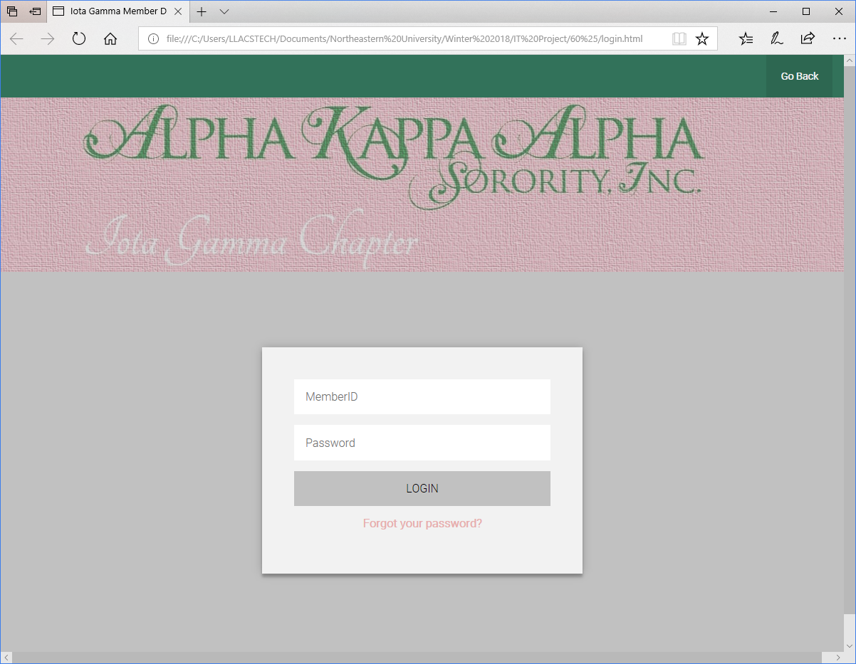
Where we left off:
The Webpages

Slide 3
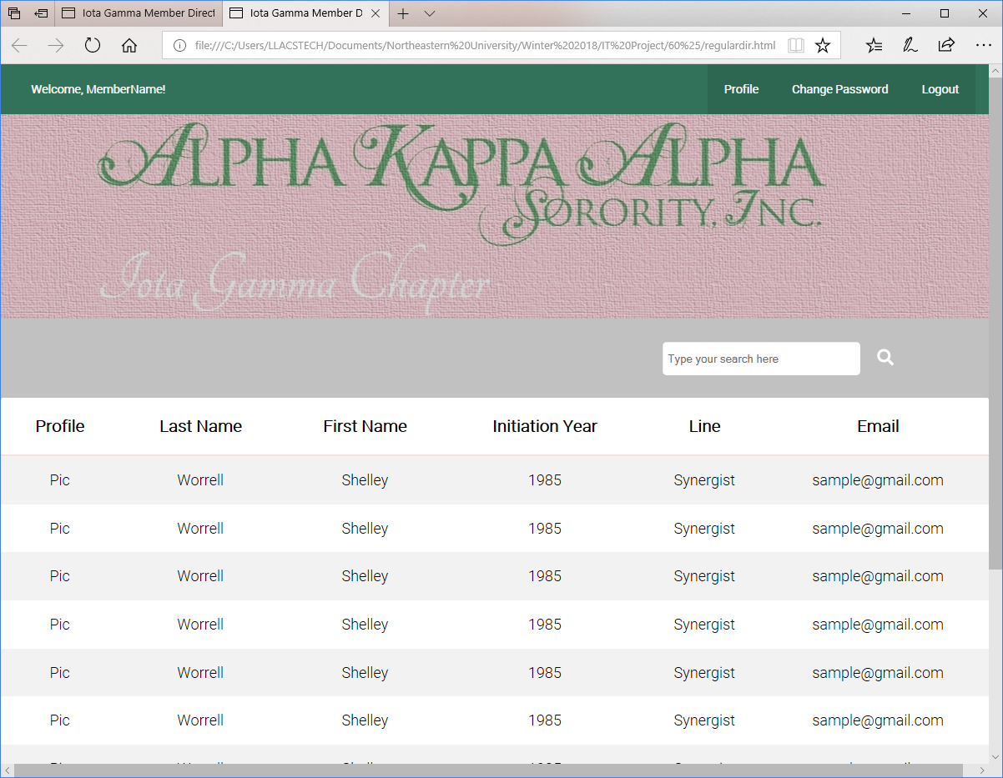
User Has Logged in
The Webpage

Slide 4
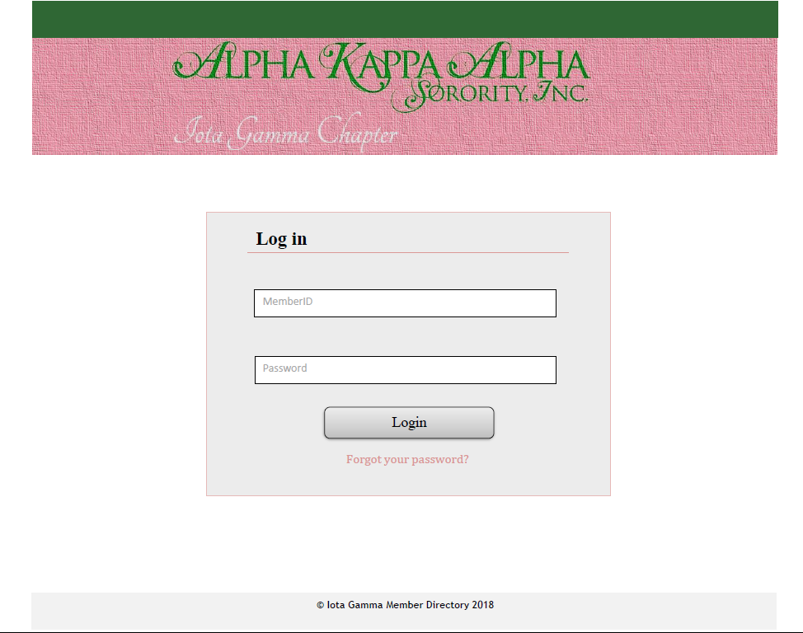
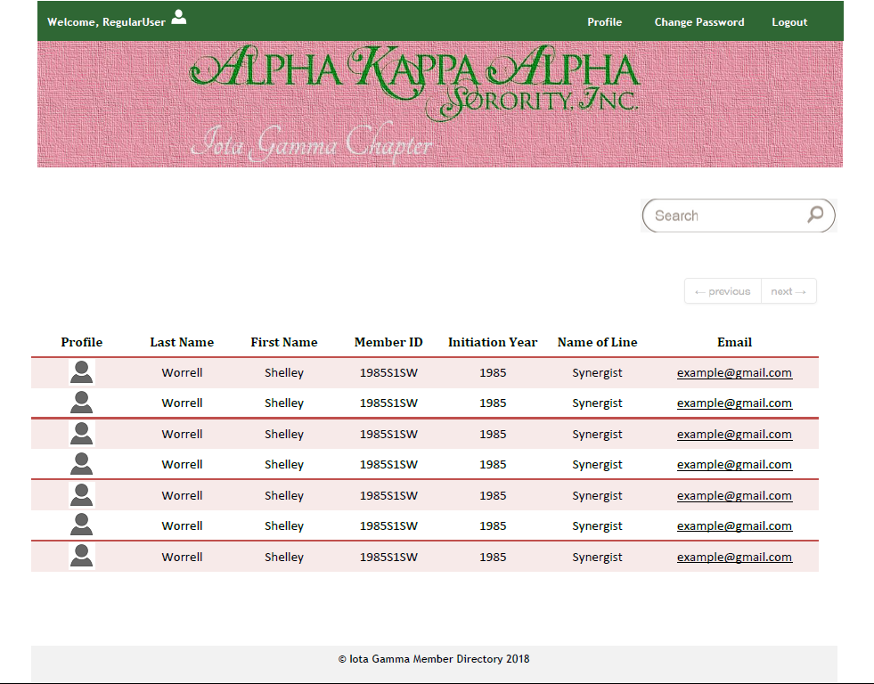
Where we are now:
Links::

Slide 5
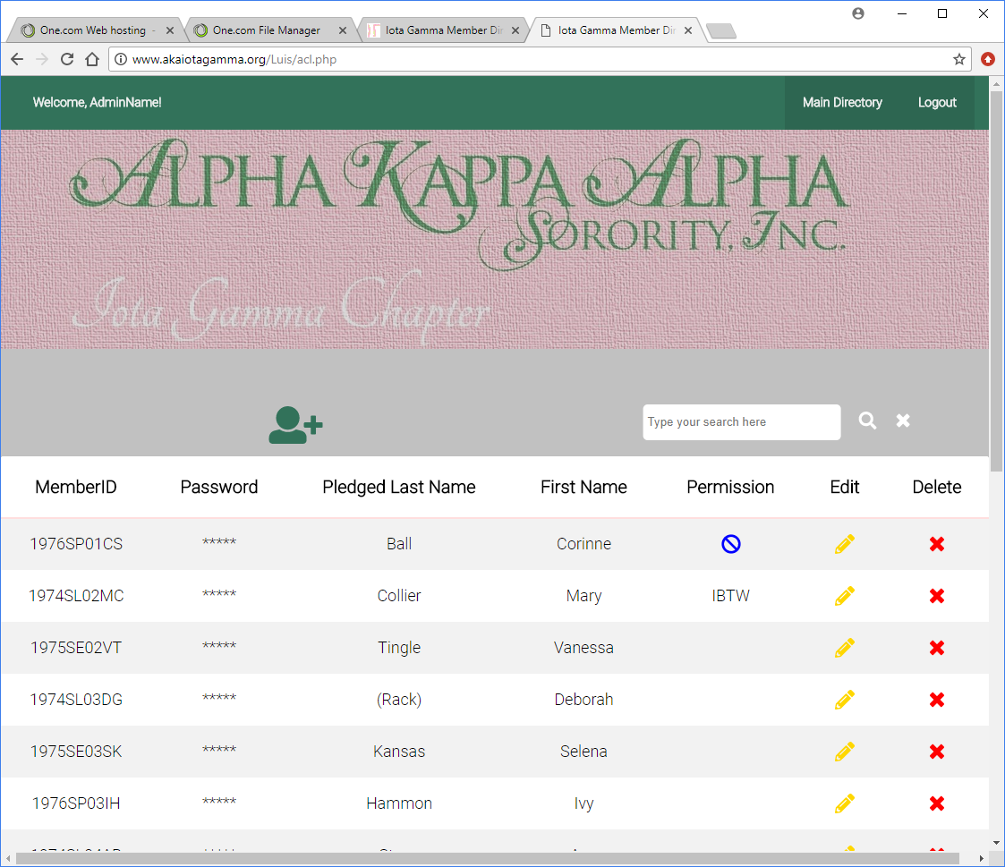
Where we are now:
Links::

Slide 6
The Schedule
Target Date | Major Milestones
April 18, 2018 | Testing Complete
April 20, 2018 | System Launch
April 24, 2018 | Documentation Complete
April 27, 2018 | Project Closure
May 11 | GRADUATION

Slide 7
Potential Risks
Debugging might take more time than anticipated

